Slide 1



Growth Deficiency Detection and Treatment Suggestion Using AI
AI
PRESENTED BY:
Bar Matzliah, Randa Assadi
SUPERVISED BY: Dr. Natali Levi
Capstone Project – Phase A – 25-2-D-18
PAGE 01
Notes:
Hello my name is bar and this is Randa . We’ll introduce our capstone project, which focuses on using artificial intelligence to support the diagnosis and treatment of growth deficiencies in children. This project was supervised by Dr. Natali Levi

Slide 2
Introduction
Growth Deficiency (FTT): Failure to Thrive (FTT) is a critical condition where children fail to meet expected growth milestones, with potentially lifelong consequences if left undiagnosed
Current Diagnosis: Manual monitoring, growth charts, specialist referrals.
Problem: Diagnosis is slow, subjective, and disconnected from medical literature.
Solution: Our solution will be a prototype web-based AI system that analyzes literature to support early-stage diagnosis and intervention for FTT.
PAGE 02
Notes:
We begin with the core motivation behind our project—Failure to Thrive, or FTT. This is a serious pediatric condition characterized by growth that is significantly below expected levels. If not addressed early, FTT can lead to long-term cognitive and physical impairments. The current methods for diagnosing FTT are slow and heavily dependent on human interpretation. We saw an opportunity to use AI to streamline this process, making diagnosis faster, more accessible, and ultimately, more accurate.

Slide 3

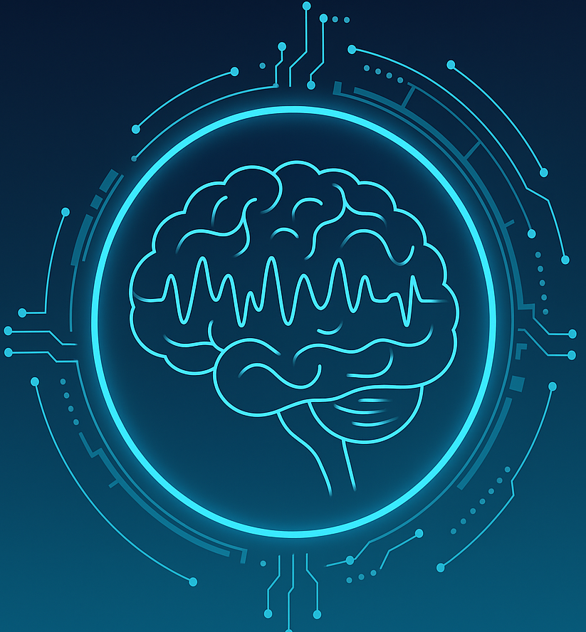
OVERVIEW OF FTT
1.
Symptoms
Below-normal weight/height percentile, developmental delays
2.
Causes
Nutritional issues, hormonal imbalance, chronic illness, genetics
3.
Why Early Detection Matters
Prevents long-term complications and enables timely intervention.
PAGE 03
Notes:
FTT includes a wide spectrum of symptoms such as poor weight gain, stunted height, and delayed development. These symptoms can stem from various causes, including nutrition deficiencies, hormonal imbalances, or even genetic factors. What makes FTT particularly challenging is that it often goes unnoticed until damage has already been done. That’s why early detection is essential. By modeling these symptoms and causes in our system, we aim to catch warning signs earlier.

Slide 4


PROBLEM WITH CURRENT METHODS
- Growth charts require long-term observation
- Specialist referrals not always accessible
- Lack of AI-based systems tailored to pediatric growth analysis or literature-based decision support
- Parents have no tools to understand medical reports/articles
PAGE 04
Notes:
Today, pediatricians typically rely on manual growth chart tracking and long-term observation to detect FTT. This can take several months and often depends on regular doctor visits. In many regions, access to pediatric specialists is limited. Also, many parents struggle to understand clinical reports and symptoms. We realized that there is no system currently available that can quickly interpret structured medical data and provide a preliminary diagnosis—especially not one aimed at non-specialist users like parents.

Slide 5

Platform Scope & Target Users
- Web Platform: Accepts structured clinical input (age, weight, height, symptoms)
- AI Engine: Uses prompt engineering and LLMs to extract diagnosis and treatment suggestions
- For Whom? Doctors, researchers, and especially parents. The system is designed for accessibility, accuracy, and explainability.
PAGE 05
Notes:
Our proposed solution is a web-based system that serves two main user types: doctors and parents. The system allows users to input structured clinical data—such as age, gender, weight, height, and symptoms—through a friendly UI. The backend uses prompt engineering with AI models to process this data and generate diagnostic insights. Our goal is to deliver results that are both medically relevant and easy to understand, closing the gap between clinical knowledge and practical usage.

Slide 6
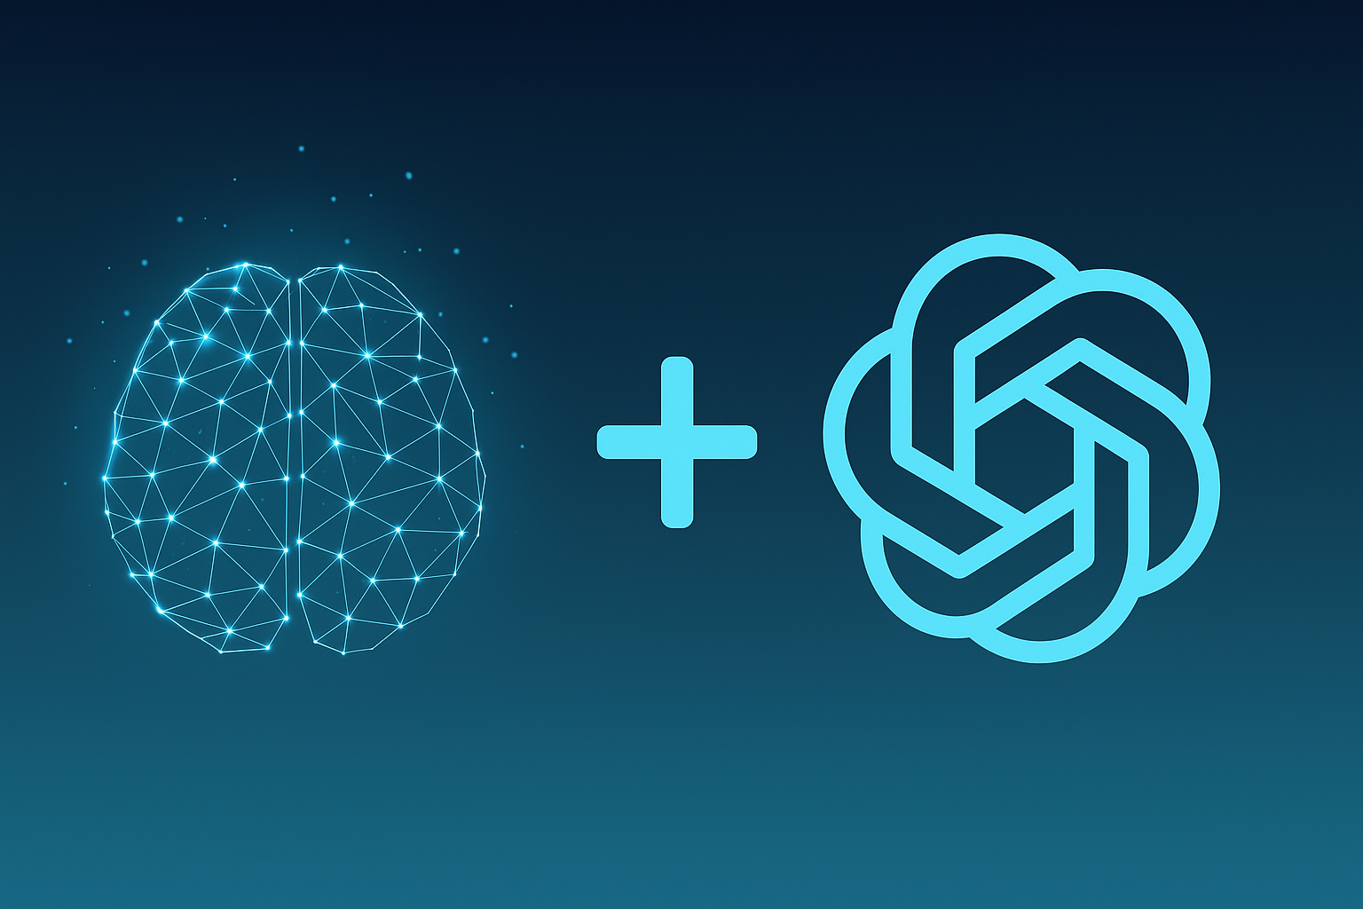
WHAT IS NLP + PROMPT ENGINEERING?
- NLP: Enables machines to understand medical texts
-Prompt Engineering: Involves designing targeted instructions to guide the AI model toward relevant and accurate medical outcomes.
-Why AI for Medical Literature?: Keeps pace with growing volume of medical knowledge
- Why Not Just Use ChatGPT?: Unlike general tools like ChatGPT, our system is medically focused and trained on validated literature.
PAGE 06
Notes:
Natural Language Processing, or NLP, enables machines to understand and interpret human language. In our case, we use NLP to help the system understand medical terminology. Prompt engineering is a key technique where we craft the inputs—called prompts— in such a way that the AI model returns highly relevant answers. This is particularly important in the medical domain, where precision and context are essential. We use this method to query AI models against trusted literature and extract meaningful results. Unlike tools like ChatGPT that gives us open-ended answers, our system works with structured clinical inputs and carefully designed prompts. It focuses the AI on specific sections of medical literature, allowing it to extract accurate and relevant clinical information. This improves trust and makes the system safer for pediatric use. The goal is not just to generate text, but to simulate diagnostic reasoning in a transparent way.

Slide 7

SYSTEM WORKFLOW
Submit structured clinical data: age, weight, height, and symptoms
1.
2.
Process data using AI engine
3.
Generate preliminary diagnosis
4.
Generate diagnosis and suggestions
5.
Display results with confidence score and rationale
PAGE 07
Notes:
Let’s walk through the process a user would experience. First, the user enter physical structured data like age gender weight and Hight along with symptoms . The backend uses prompt engineering with AI models to process this data and generate diagnostic insights and possible treatment suggestions. These are displayed to the user along with confidence scores and supporting rationale. This entire process happens within seconds, providing a smooth and informative experience.

Slide 8
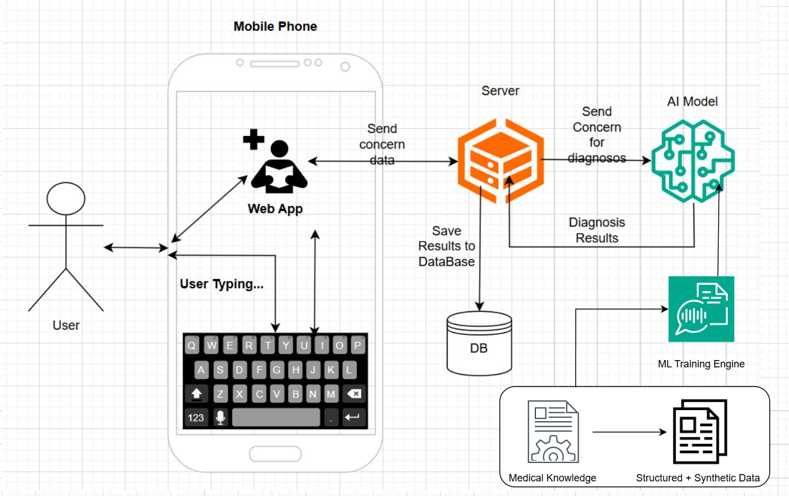
SYSTEM Architecture
PAGE 08
Notes:
This diagram illustrates the architectural layers of our system. The frontend is built using React for a dynamic and responsive user interface. Our Flask backend handles user requests, performs prompt construction, and sends the prompt to the AI engine—possibly using models like BioBERT or GPT. Results are returned, interpreted, and stored in a SQL database like MongoDB for future retrieval. This modular design ensures performance, scalability, and security. In addition, we included a dedicated Machine Learning Training Engine that uses real and synthetic pediatric data along with medical literature to train and optimized our system

Slide 9
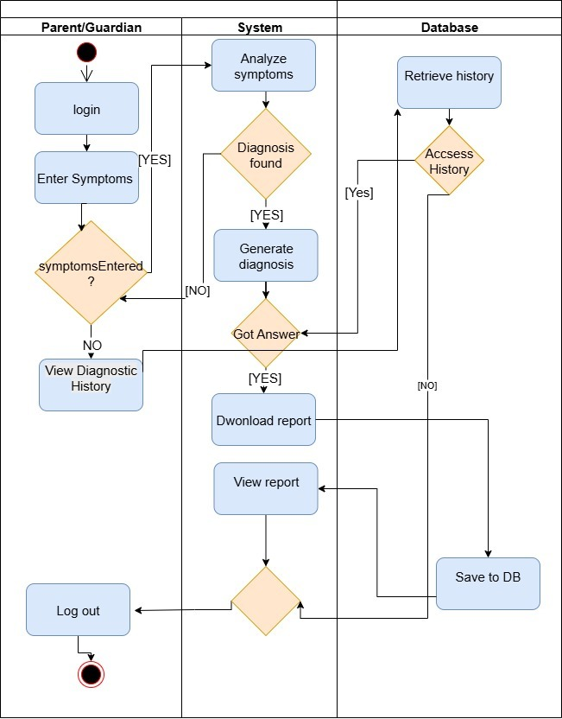
Activity Diagram
PAGE 09
Notes:
This activity diagram provides a clear overview of the user's journey. It starts with data entry, proceeds to AI processing, and ends with result presentation. We included decision points and feedback loops to handle scenarios like invalid inputs or missing data. This helped us design a more robust system that can respond appropriately under different conditions.

Slide 10
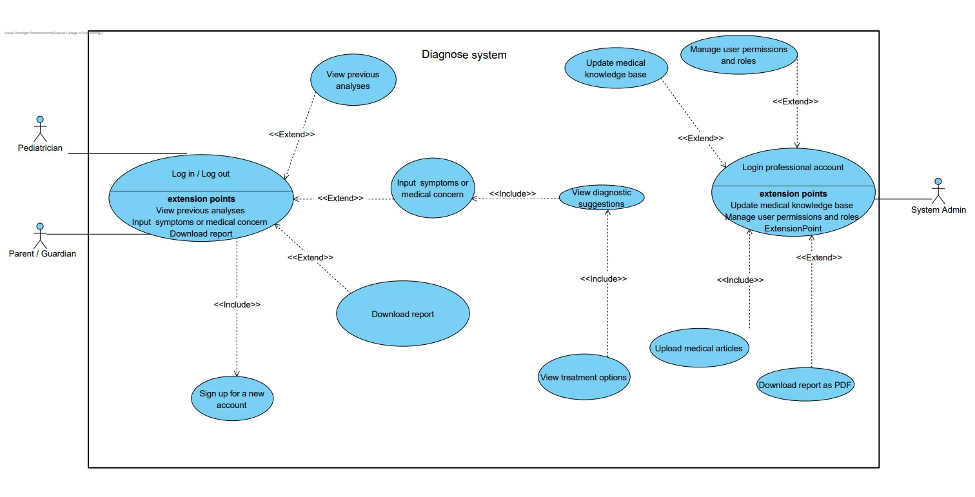
Use Case Diagram
PAGE 10
Notes:
Here, we identify the major actors—parents and doctors—and outline their interactions with the system. These include submitting new cases, reviewing previous results, and accessing educational content. This diagram helped us prioritize which features to develop and how to structure user flows for maximum usability.

Slide 11

System Overview
- Input Panel: Submit clinical data (age, weight, height, symptoms)
- Results View: Diagnosis + Suggested treatment
- History Tab: View previous analyses
- Educational Section: Knowledge Center for Parents: FTT FAQs, Articles, and Growth Guidelines
PAGE 11
Notes:
This slide shows how we divided the system into functional blocks: clinical input, diagnostic results, history tracking, and knowledge resources. Each of these areas was designed with a specific user need in mind, and we constantly referred back to user personas to guide our design decisions.

Slide 12
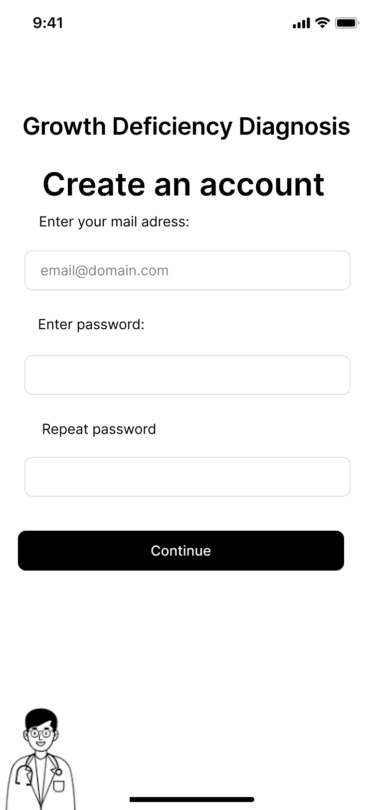
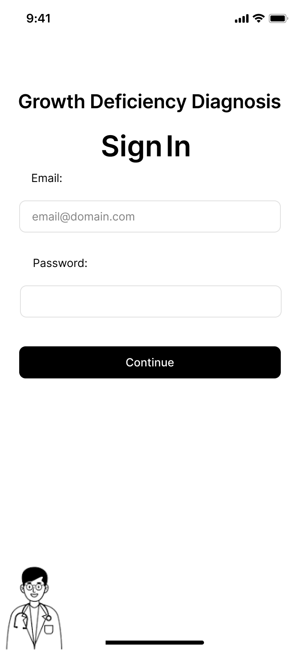
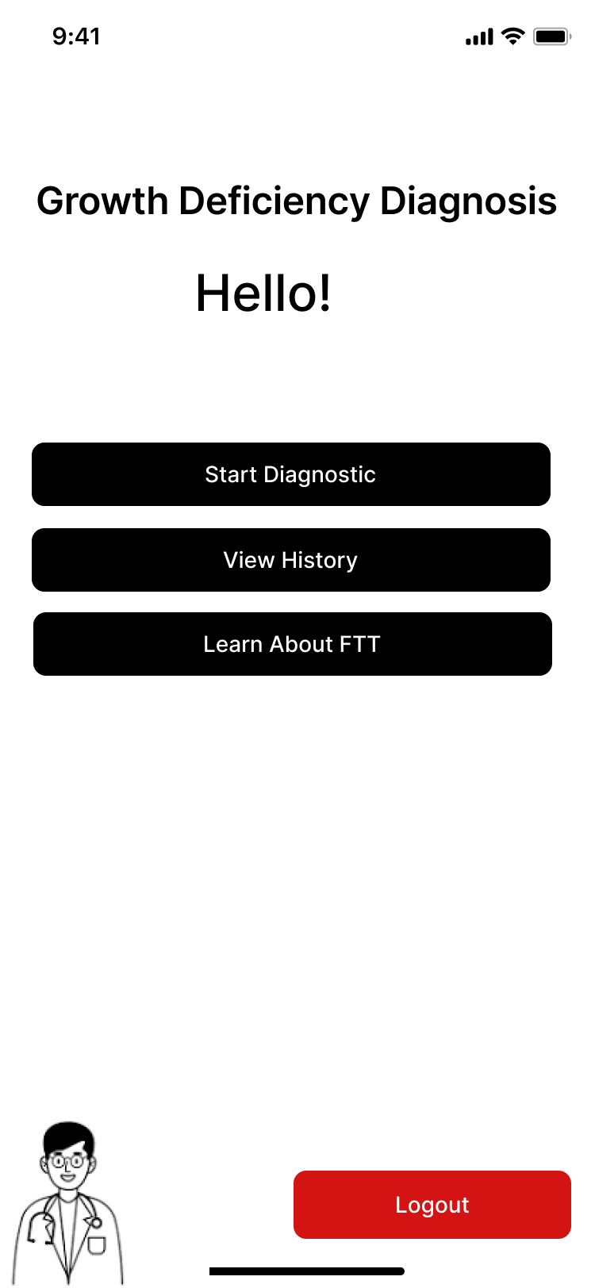
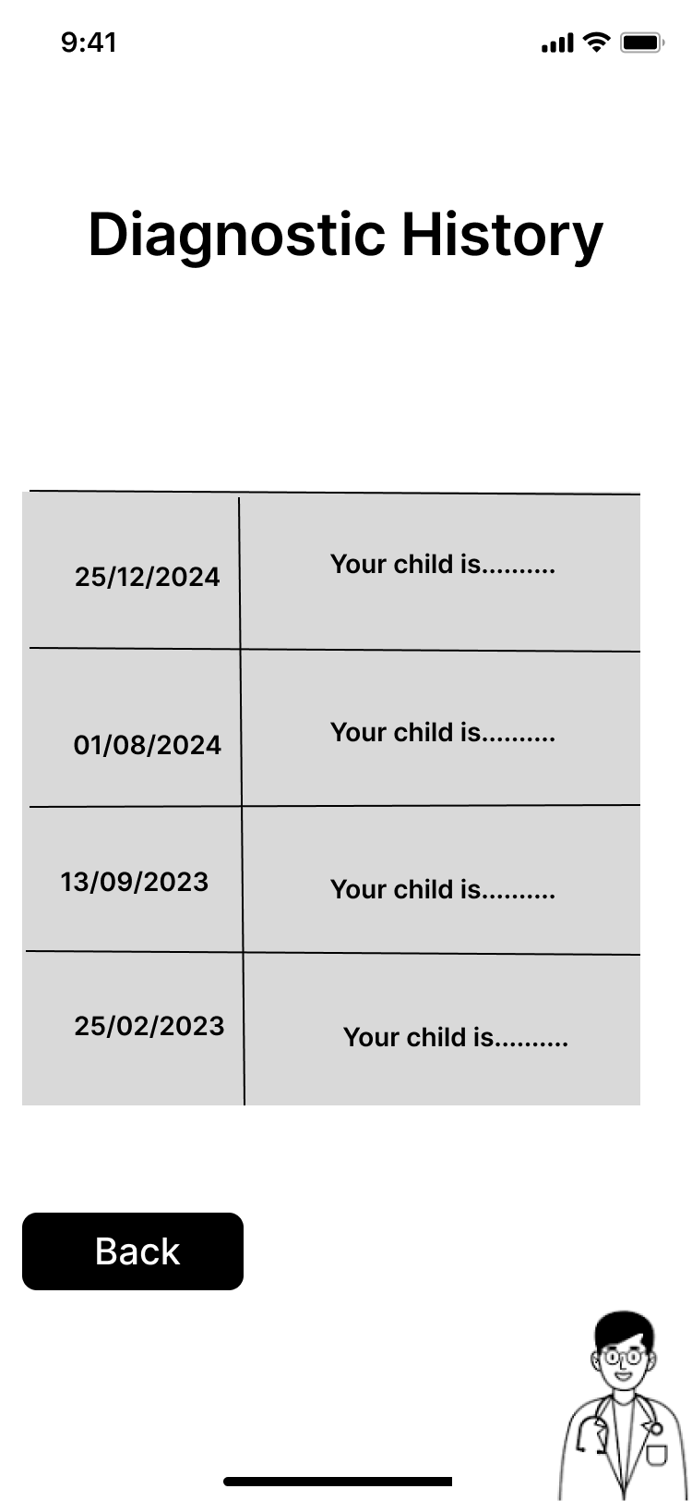
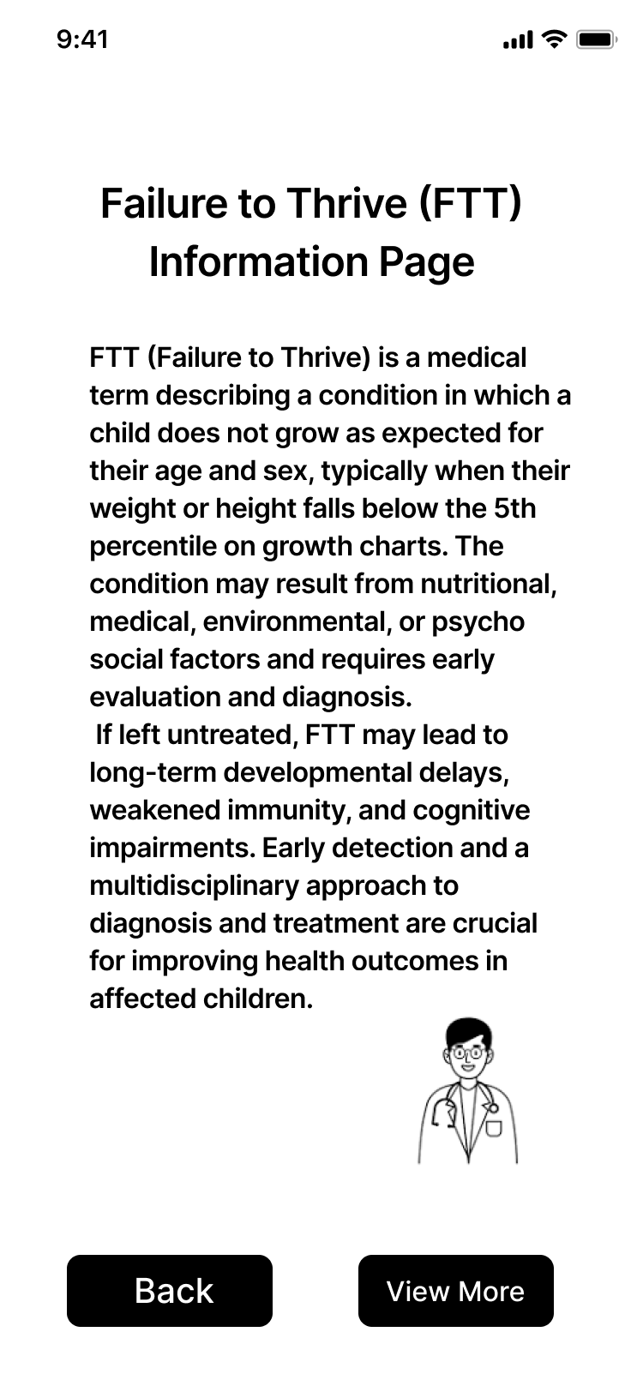
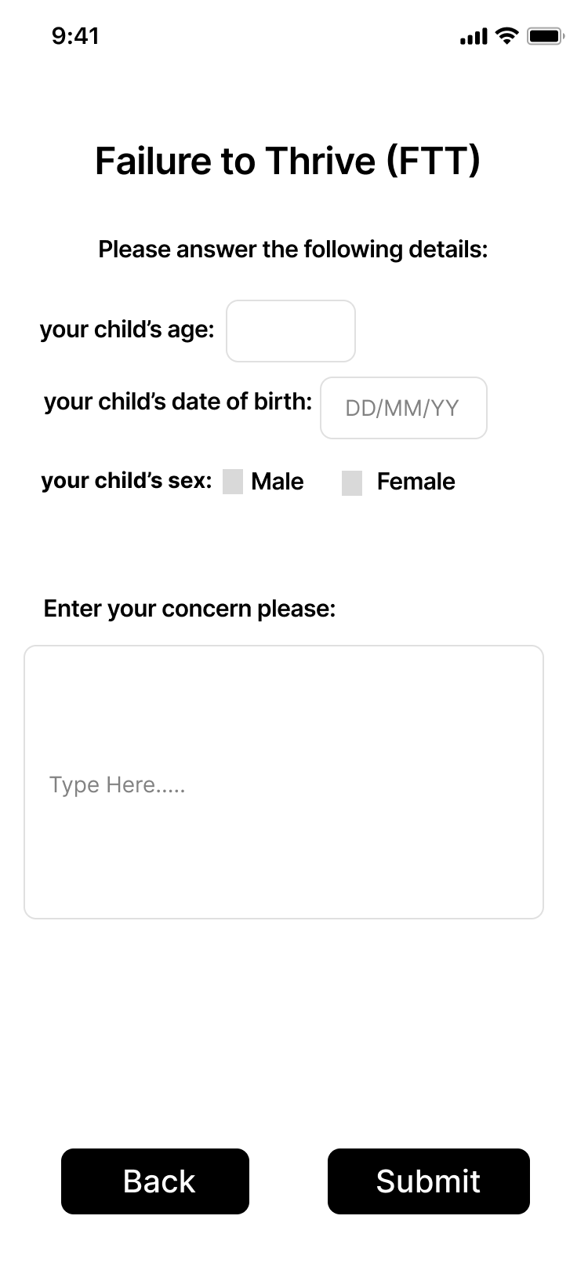
UI OVERVIEW
PAGE 12
Notes:
This is a closer look at what users will see. We used clear fonts, intuitive layouts, and minimal technical jargon to ensure accessibility. Our aim is to make users—especially parents—feel confident using the system, even if they have no medical or technical background. The design focuses on guiding users step-by-step without overwhelming them.

Slide 13
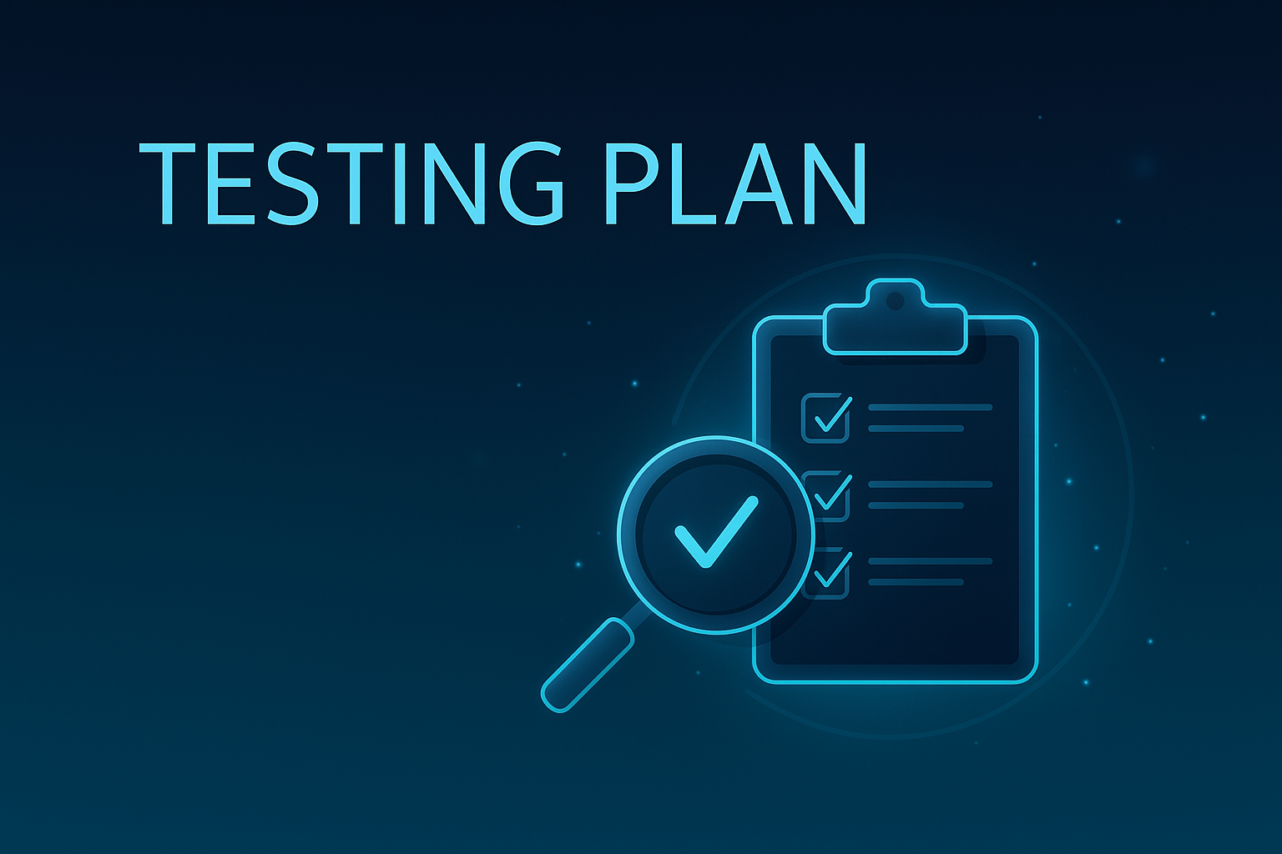
TESTING PLAN
- Model Testing: Accuracy of diagnosis + treatment suggestions
- Usability Testing: Questionnaire for parents and doctors
- Performance Testing: Load, latency under multiple users
PAGE 13
Notes:
Our testing covered model accuracy, usability, and backend performance. But beyond that, we used 100 real pediatric cases with confirmed FTT diagnoses to evaluate the model's reliability. We compared the AI output to the physician’s diagnosis and used the feedback to refine our prompts and system behavior. This real-world testing approach helps ensure the tool will work under clinical conditions, not just in theory.

Slide 14
Core Functionality Tests
Test # | Module | Core Function Tested | Description
1 | Web Application UI | Data Input and Submission | Fill clinical fields (age, height, weight, symptoms) and press 'Submit'. Expect successful transfer to backend.
2 | Prompt Engine | Diagnosis Accuracy | Submit known FTT case and verify that diagnosis aligns with expected output.
3 | Prompt Engine | Handling of Rare or Ambiguous Input | Submit rare/atypical symptoms and ensure system provides relevant fallback or request for clarification.
4 | Backend API | Response Time | Measure time from 'Submit' to AI-generated result. Should be <5 seconds.
5 | System Integration | End-to-End Flow | Test full flow: Input → Diagnosis → Treatment → History entry → User feedback.
6 | Data Security | Input Sanitization and Privacy | Ensure personal data is not stored and all fields are sanitized on submit.
7 | Output Consistency | Repeatability of AI Results | Submit identical input multiple times and confirm consistent diagnostic results
PAGE 14
Notes:
Here we list specific scenarios we tested. For example, submitting valid clinical data should return a correct diagnosis. We also tested how the system handles edge cases, like invalid or incomplete input. Additionally, we looked at response times and checked whether the AI gives consistent results when the same input is submitted multiple times. These tests ensure reliability and trust in real-world usage.

Slide 15

OUR UNIQUENESS
- First tool combining AI + real-time literature analysis for pediatric growth issues
- Focus on non-specialist accessibility (parents!)
- Real-world FTT case comparison for validation
PAGE 15
Notes:
Our system will stand out by combining medically verified data, literature-based AI, and a simple interface for parents. We will start with 100 real cases and generated around 600 fake data examples for future training. This mix of real and generated data lets us train the system to recognize both typical and rare conditions. It helps bridge the gap between research-level AI and real-world clinical support.

Slide 16

OUR CHALLENGES
- Challenge: Ensuring medical accuracy
Solution: Compare outputs with known FTT diagnoses
- Challenge: Usability for non-technical users
Solution: Clean UI + feedback from parents
-Challenge: Lack of labeled FTT dataset
Solution: Use of synthetic prompts and expert-reviewed validation
PAGE 16
Notes:
One of our biggest challenges was the lack of public datasets for FTT. We worked closely with Dr. Natali Levi to analyze and understand 100 real cases. Based on that data, we will generate fake data examples simulating different patient scenarios and symptom profiles.
In Phase B, we plan to use the original 100 real cases to generate 600 to 700 synthetic profiles. These will form the foundation for more advanced training using traditional machine learning approaches.

Slide 17
Conclusion
Our system bridges the gap between medical literature and day-to-day diagnostic decisions. By empowering both professionals and parents, we accelerate the early detection and treatment of growth deficiencies in children.
PAGE 18
Notes:
To conclude, our system aims to bring AI into the hands of everyday users—parents and general practitioners—so they can detect pediatric growth issues early. We combine technical innovation with clinical relevance and human-centered design. We hope our solution will become a valuable tool in pediatric diagnostics.

Slide 18
THANK
YOU!
Empowering families and physicians through intelligent diagnosis
Any Questions?
PAGE 19
Notes:
Thank you for listening. We’d love to hear your feedback and questions. We’re excited to continue this project in Phase B and further refine the system based on your insights and support.

